Slide 1
Developing applications using Spring Framework
Bean Management in Spring

Slide 2
Objectives
On completion of this session you will be able to
  Explain BeanFactory and ApplicationContext
  Explain Life Cycle of a typical Bean in Spring Container
  List the different Scopes of a Bean
  Describe the declarative Bean Creation process and Parent/Child relationship between the Beans
  Describe Method Injection into a Bean
  Explain Post Processing of a bean
  Demonstrate the use of the context specific important Interfaces.

Slide 3
BeanFactory
In a Spring-based application, the application objects will live within the Spring container.
  The container will create the objects, wire them together, configure them, and manage their lifecycle.
The BeanFactory interface standardizes the Spring bean container behavior.
  The implementations of it forms the simple container, providing basic support for DI.
Notes:
The traditional approach to creating associations between application objects (via construction or lookup) leads to complicated code that is difficult to reuse and unit test. In the best case, these objects do more work than they should. In the worst case, they are highly coupled to one another, making them hard to reuse and hard to test.
In Spring, objects are not responsible for finding or creating the other objects that they need to do their job. Instead, they are given references to the objects that they collaborate with by the container.

Slide 4
BeanFactory
A BeanFactory is an implementation of the Factory design pattern.
  Implementation class object will load bean definitions stored in a Configuration Source (such as XML) and configure the beans.

Slide 5
BeanFactory

Slide 6
Simple Bean Configuration File
bean : The Element which is most basic configuration unit in Spring. It tells Spring Container to create an Object.
id : The Attribute which gives the bean a name by which it
will be referred to in the Spring Container.
class : The Attribute which tells Spring the type of a Bean.
The configuration file named employees.xml
<?xml version="1.0" encoding="UTF-8"?>
<beans>
<bean id="emp" class="com.emp.Employee">
</bean>
</beans>
Notes:
The <bean> element is the most basic configuration unit in Spring.
It tells Spring Container create an object for us.
The id attribute gives the bean a name by which it will be referred to in the Spring container.
the class attribute tells Spring what type the bean will be.
When the Spring container loads its beans, it will instantiate the emp bean using the default constructor.

Slide 7
Accessing Bean from BeanFactory
//Create the Resource of type FileSystemResource to locate xml file
Resource resource = new FileSystemResource("employees.xml");
//create the beanFactory object from xml resource
BeanFactory factory = new XmlBeanFactory(resource);
//request the “Employee” object with id=“emp” from BeanFactory
Employee emp = (Employee) factory.getBean("emp");
after getBean(), the factory will instantiate the bean and set the bean’s properties using DI. The object emp will be destroyed by the BeanFactory when it’s scope ends
Notes:
Note:
XmlBeanFactory can be created using one of several Resource implementations to
allow Spring configuration details to come from a variety of sources like
ByteArrayResource, ClassPathResource, FileSystemResource, InputStreamResource, UrlResource etc

Slide 8
Types of Resource Implementations
Resources | Purpose
FileSystemResource | It is retrieved from the FileSystem.
InputStreamResource | It is retrieved from an InputStream.
ByteArrayResource | Contents are given by array of bytes.
ClassPathResource | It is retrieved from the Classpath.
UrlResource | It is retrieved from the given URL.
ServletContext Resource | A resource that is available in Servlet Context.

Slide 9
How DI/IoC Container works
In Inversion Of Control (IoC) control is inverted back to the Container to support the object dependencies.
IoC container creates the POJO objects and provides dependent objects to them.
  These POJO objects are not tied to any framework.
The declarative configuration for POJO objects is defined with unique identities (id) in XML.
  These are known as bean definitions.

Slide 10
How DI/IoC Container works
The IoC container at runtime identifies POJO bean definitions, create bean objects and return them to the Application.
IoC container manages dependencies of objects.

Slide 11
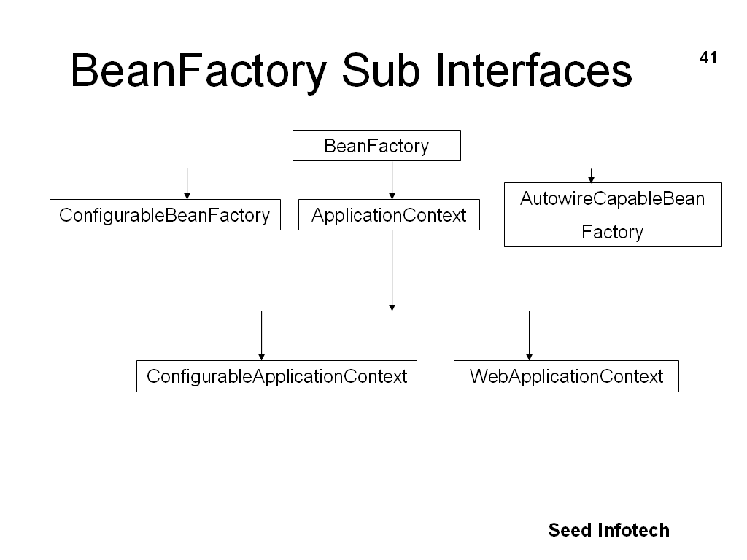
BeanFactory – Interface Hierarchy
Notes:
http://docviewer.net/docs/javaee/spring2.5.5/api/org/springframework/beans/factory/xml/XmlBeanFactory.html

Slide 12
ApplicationContext
The Interface ApplicationContext extends from BeanFactory
  standardizes the bean container for J2EE application context such as web applications.
To build application in a J2EE environment, one should use implementation of ApplicationContext as it supports additional features like
  Means for resolving text messages, including support for i18n.
  Ability to publish events to beans that are registered as listeners.
Notes:
Among the many implementations of ApplicationContext are three that are
commonly used:
■ ClassPathXmlApplicationContext—Loads a context definition from an
XML file located in the classpath, treating context definition files as classpath
resources.
■ FileSystemXmlApplicationContext—Loads a context definition from an
XML file in the file system.
■ XmlWebApplicationContext—Loads context definitions from an XML file
contained within a web application.

Slide 13
Accessing Bean from ApplicationContext
//Create the Context of type FileSystemXmlApplicationContext to locate xml file
ApplicationContext context = new
FileSystemXmlApplicationContext(“employees.xml”);
//request the “Employee” object with id=“emp” from Context
Employee emp = (Employee)context.getBean(“emp");
Notes:
The difference between these uses of FileSystemXmlApplicationContext and ClassPathXmlApplicationContext is that FileSystemXmlApplicationContext will look for.xml in a specific location within the file system, whereas ClassPathXmlApplicationContext will look for .xml anywhere in the classpath (including JAR files).

Slide 14
Types of Application Contexts
ClassPathXmlApplicationContext
  Loads a context definition from an XML file located in the classpath, treating context definition files as classpath resources
FileSystemXmlApplicationContext
  Loads a context definition from an XML file in the file system
XmlWebApplicationContext
  Loads context definitions from an XML file contained within a web application
Notes:
Note :
The difference between these uses of FileSystemXmlApplicationContext and ClassPathXmlApplicationContext is that FileSystemXmlApplicationContext will look for.xml in a specific location within the file system, whereas ClassPathXmlApplicationContext will look for .xml anywhere in the classpath (including JAR files).

Slide 15
LifeCycle of a Bean in Spring Container
Instantiate
Populate
Properties
BeanNameAware's
setBeanName()
BeanFactoryAware's
setBeanFactory()
ApplicationContextAware's
setApplicationContext()
InitializingBean's
afterPropertiesSet()
Call Custom
init-method
DisposableBean's
destroy()
Call Custom
destroy-method
Notes:
Note :: LifeCycle of a Bean in BeanFactory and in ApplicationContext is almost similar apart from the
additional state “ApplicationContextAware's setApplicationContext()” in later case.
The steps taken in the life of a bean
Step Description
1. Instantiate :: Spring instantiates the bean.
2. Populate properties :: Spring injects the bean’s properties.
3. Set bean name :: If the bean implements BeanNameAware, Spring passes the
bean’s ID to setBeanName().
4. Set bean factory :: If the bean implements BeanFactoryAware, Spring passes the
bean factory to setBeanFactory().
5. Postprocess (before initialization) :: If there are any BeanPostProcessors, Spring calls their
postProcessBeforeInitialization() method.
6. Initialize beans :: If the bean implements InitializingBean, its afterPropertiesSet() method will be called. If the bean
has a custom init method declared, the specified initialization method will be called.
7. Postprocess (after initialization) :: If there are any BeanPostProcessors, Spring calls their postProcessAfterInitialization() method.
------------------------------------------------------------------------------------------------------------------------------
Bean is ready to use. At this point the bean is ready to be used by the application and will
remain in the bean factory until it is no longer needed.
8. Destroy bean. If the bean implements DisposableBean, its destroy()
method will be called.
If the bean has a custom destroy-method declared, the specified method will be called.

Slide 16
Typical Bean Life Cycle
Instantiate
  Spring instantiates the bean
Populate properties
  Spring injects the bean’s properties
Set bean name
  If the bean implements BeanNameAware, Spring passes the bean’s ID to setBeanName()
Set bean factory
  If the bean implements BeanFactoryAware, Spring passes the bean factory to setBeanFactory()
Postprocess (before initialization)
  If there are any BeanPostProcessors, Spring calls their postProcessBeforeInitialization() method

Slide 17
Typical Bean Life Cycle …Continued
Initialize beans
  If the bean implements InitializingBean, its afterPropertiesSet() method will be called
  If the bean has a custom init method declared, the specified initialization method will be called
Postprocess (after initialization)
  If there are any BeanPostProcessors, Spring calls their postProcessAfterInitialization() method
  Bean is ready to use and will remain in the bean factory until it is no longer needed
Destroy bean
  If the bean implements DisposableBean, its destroy() method will be called
  If the bean has a custom destroy-method declared, the specified method will be called

Slide 18
Injecting the Dependencies
The IoC container will Inject the dependencies in three ways
  Create the POJO objects by using default constructors and injecting the dependent properties by calling the setter methods.
  Create the POJO objects by using parameterized constructors and injecting the dependent properties through the constructor.
  Implements the method Injection.

Slide 19
Injecting Properties by calling Setters
public Class Employee {
private String fname;
private String lname;
public Employee() {
}
public void setFname(String f) {
fname = f;
}
public void setLname(String l) {
lname = l;
}
}
<bean id="emp" class="com.emp.Employee">
<property name=“fname” value=“a” />
<property name=“lname” value=“b” />
</bean>

Slide 20
Injecting Properties through Constructors
public Class Employee {
private String fname;
private String lname;
public Employee(String f,String l )
{
fname = f;
lname = l;
}
}
<bean id="emp" class="com.emp.Employee">
<constructor-arg value="amit" />
<constructor-arg value=“roy" /> </bean>

Slide 21
Dependent Beans
A bean is a dependency of another bean is expressed by the fact the one bean is set as a property of another.
It is achieved with the <ref/> element in XML based configuration metadata of beans.
To specify indirect dependency, depends-on attribute is used to express a dependency on a single another bean. It will trigger the initialization of the dependent bean.

Slide 22
Method injection
With setter and constructor injection, you were injecting values into a bean’s properties. BUT method injection lets you inject entire method definitions into a bean.

Slide 23
Inheritance in Beans
The <bean> element provides two special attributes:
  parent
    Indicates the id of a <bean> that will be the parent of the <bean> with the parent attribute.
    The parent attribute is to <bean> what extends is to a Java class.
  abstract
    If set to true, indicates that the <bean> declaration is abstract.
    It should never be instantiated by Spring.

Slide 24
Controlling the Bean Creation
The Bean creation can be controlled in following manner:
  Control how many instances of a specific bean are created, whether it is one instance for the entire application, one instance per user request, or a brand-new instance each time the bean is used.
  Create beans from static factory methods instead of public constructors.
  Initialize a bean after it is created and clean up just before it is destroyed.
Notes:
Spring’s bean scopes let you declare the scope under which beans are created without hardcoding
the scoping rules in the bean class itself.
Scope What it does
singleton :: Scopes the bean definition to a single instance per Spring container (default).
Prototype :: Allows a bean to be instantiated any number of times (once per use).
request :: Scopes a bean definition to an HTTP request. Only valid when used with a webcapable
Spring context (such as with Spring MVC).
session :: Scopes a bean definition to an HTTP session. Only valid when used with a webcapable
Spring context (such as with Spring MVC).
global-session :: Scopes a bean definition to a global HTTP session. Only valid when used in a
portlet context.

Slide 25
Bean’s scope attribute values
Scope Value | Meaning
singleton | Only single instance of bean is created inside Spring Container
prototype | Instance of Bean will be created once per use
request | Scopes a bean definition to an HTTP request (only valid in Spring MVC)
session | Scopes a bean definition to an HTTP session (only valid in Spring MVC)
global-session | Scopes a bean definition to a global HTTP session (Only valid when used in a portlet context)
Notes:
Note :
By default the scope has “singleton” value in Spring Container.
Developer of a bean has to take care of the Thread-Safety.
Scope=request or session is Only valid when used with a webcapable Spring context (such as with Spring MVC).

Slide 26
AutoWiring of Beans
Rather than explicitly wiring all of your bean’s properties, you can have Spring automatically figure out how to wire beans together by setting the autowire property.
Spring provides four types of autowiring:
  byName
    Attempts to find a bean in the container whose name (or ID) is the same as the name of the property being wired. If a matching bean is not found, the property will remain unwired.
  byType
    Attempts to find a single bean in the container whose type matches the type of the property being wired. If no matching bean is found, the property will not be wired.
Notes:
For byType, If more than one bean matches, an
org.springframework.beans.factory.UnsatisfiedDependencyException will be thrown.
For constructor, In the event of ambiguous beans or ambiguous constructors, an
org.springframework.beans.factory.UnsatisfiedDependencyException will be thrown.

Slide 27
AutoWiring of Beans …Continued
  constructor
    Tries to match up one or more beans in the container with the parameters of one of the constructors of the bean being wired.
  autodetect
    Attempts to autowire by constructor first and then using byType.

Slide 28
Quick Recap
On completion of this session you will be able to
  Explain BeanFactory and ApplicationContext
  Explain Life Cycle of a typical Bean in Spring Container
  List the different Scopes of a Bean
  Describe the declarative Bean Creation process and Parent/Child relationship between the Beans
  Describe Method Injection into a Bean
  Explain Post Processing of a bean
  Demonstrate the use of the context specific important Interfaces.

